Slide 1

E-COMMERCE WEBSITE
ON AWS CLOUD
INDUSTRY E-COMMERCE

Slide 2
BUSINESS OBJECTIVE
CREATE AN E-COMMERCE WEBSITE THAT USES AWS TO HELP CUSTOMERS PURCHASE A – Z THINGS WITH JUST A CLICK AWAY BY SITTING IN THE COMFORT OF THEIR HOMES ANYTIME, ANYWHERE

Slide 3





Project Team
Geeta Brijlal Kotwani
Vivek Girishbhai Makani
Srinivas Kashyap
Akshay Sudhir Kadam
Jayesh Bahl

Slide 4

WHAT IS CLOUD COMPUTING?
Cloud Computing is the on-demand availability of computer system resources, such as data storage and computing power with/without active management of the user. This a pay as you use type of service.

Slide 5






Eliminate costly technical debt and reallocate resources so you can deliver high-value revenue and generate projects faster.
WHY AWS CLOUD?
IInnovate faster and solidity your competitive advantage by merging startup agility with enterprise experience and resources.
AWS excels in security & compliance with data encryption, network security, IAM, & industry certifications, boosting customer trust

Slide 6
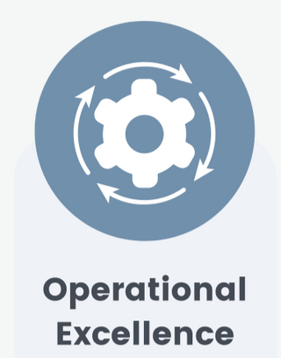

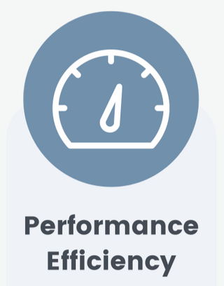


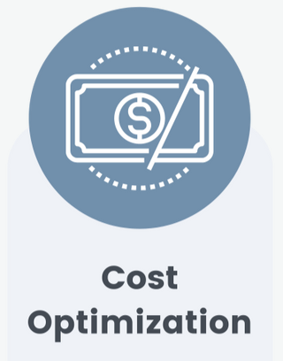
The Pillars of Architecture

Slide 7
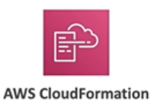


Operational Excellence
Covers the processes and procedures followed for deploying, managing, monitoring and operating a cloud workload. Mentioned below are the best practice areas for Operational Excellence on Cloud.
Prepare :
Operate:
Evolve:
CloudWatch Dashboard

Slide 8
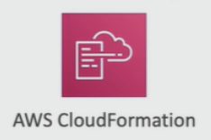
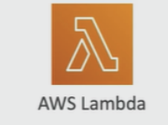
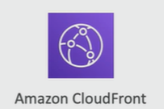
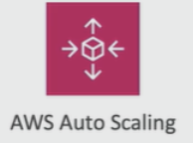
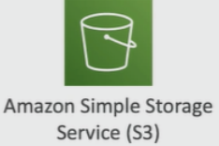
Performance Efficiency
Reviews how efficiently resources are used to deliver the functionality and how the workloads scales with increased demand. Mentioned below are the best practice areas for performance efficiency:
Monitoring:
Review:
Trade-Offs:
Selection:

Slide 9
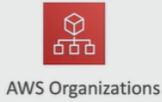



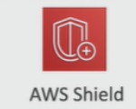

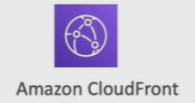
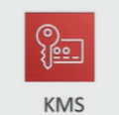

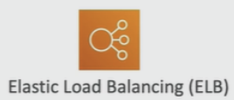
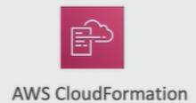
Security
Evaluates the ability of a workload to perform its function in a resilient and fault-tolerant manner, despite potential disruptions. Best practice areas for Cloud Security:
Identity and Access Management:
Detective Controls:
Infrastructure Protection:
Data Protection:
Incident Response:

Slide 10
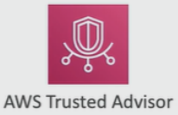
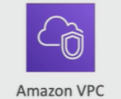
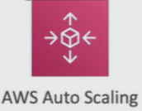

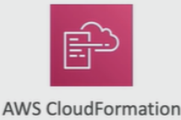


Reliability
Focuses on the protection and security of data and assets in a cloud-based solution. Below mentioned are the best practice areas for Cloud reliability.
Foundations :
Change Management:
Failure Management:

Slide 11
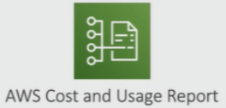

Cost Optimization
Looks at the cost efficiency of the solution, and for improvements that can reduce the expense of the workload without reducing functionality. Below mentioned are the best practice area for Cost-Saving on Cloud:
Expenditure Awareness :
Cost Effective Resources:
Matching Supply and Demand:
Optimizing Over Time:

Slide 12



Sustainability
Evaluates how the design and architecture of the workload functions with respect to how well it aligns to a sustainable future. Below mentioned are the services we used for sustainablilty.
AWS Storage Optimization
AWS Savings Plan
Lambda (Serverless Computing)

Slide 13

BUSINESS MODEL
Functional Business Requirements
• User Management: The ability to create and manage user accounts, including customer accounts and administrative accounts.
• Product Management: The ability to add, edit, and delete products, as well as manage product categories and attributes.
• Order Management: The ability to process and manage customer orders by the warehouse staff.
• Inventory Management: The ability to track inventory levels, manage stock levels, and generate low stock alerts.
Non-Functional Business Requirements
• Scalability: The ability to handle increasing levels of traffic and transactions as the business grows.
• Performance: The ability to deliver fast and responsive website performance, with fast page load times and minimal downtime.
• Security: The ability to protect customer data and transactions from cyber threats, including encryption, access controls, and regular security audits.
• Reliability: The ability to provide a dependable and uninterrupted shopping experience, even in the event of failures or outages.
• Usability: The ability to provide a user-friendly and intuitive shopping experience, with clear navigation and a visually appealing design.
• Accessibility: The ability to provide an accessible shopping experience for customers with disabilities, in accordance with relevant accessibility standards.
• Compliance: The ability to meet relevant legal and regulatory requirements, including data privacy and security standards.
• Cost Efficiency: The ability to optimize costs and minimize waste, while still delivering a high-quality shopping experience to customers.

Slide 14
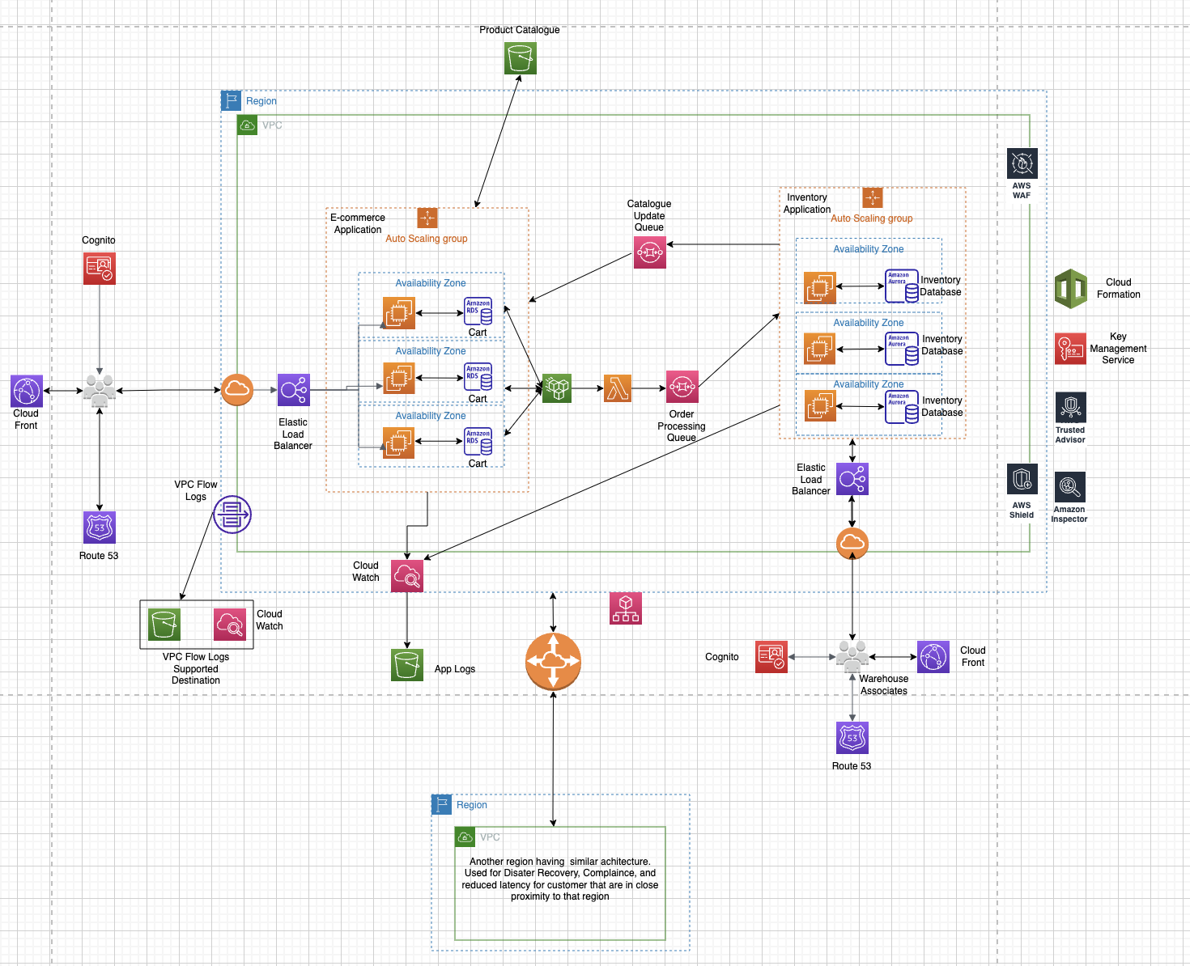
ARCHITECTURAL DIAGRAM

Slide 15
Thank You

